Slide 1
Starlab Payload Workbench
Team 16: Greyson Donley, Lucas Brickner, Fatima Sayeed
11-13-2025

Slide 2



Team Introductions
Greyson Donley
Hardware & I2C
Lucas Brickner
Power Systems
Fatima Sayeed
Embedded Systems

Slide 3
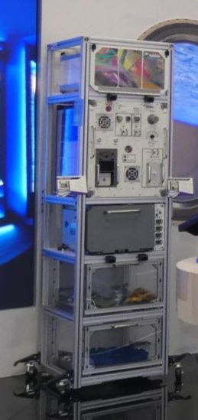
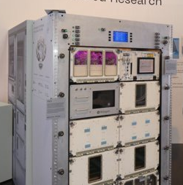
Technical Clarifications
Voltages and power per payload
Payload sensitivity to voltage fluctuations
Multiple outputs on for one payload
User interface screen
Cable management
Payload connectors, connection to source
Size requirements
What is the end goal for our system? What are the final deliverables?

Slide 4
Power System for Starlab Equipment
Problem Identification
Problem Statement:
Design Power System for Payloads
Objectives:
Supplying power to 10 payloads
Monitor and control outputs
Background:
EXPRESS Rack Technology
ISS Electric Power System
Scope:
Handle 6 voltage levels
5 DC, 1 AC connections
Power Monitoring and Control System

Slide 5
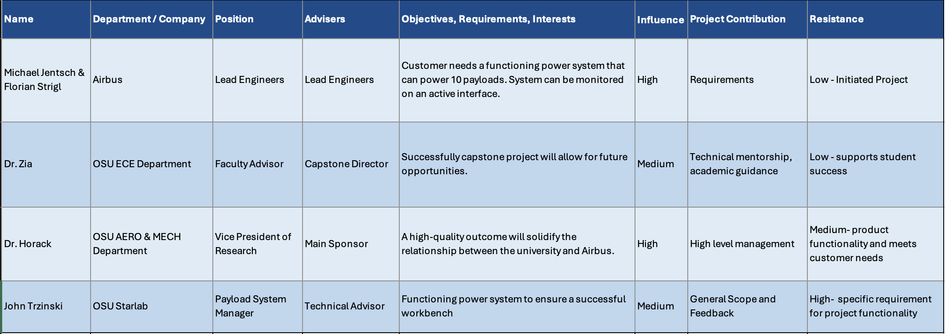
Needs Assessment

Slide 6
Requirements Table
Needs | Requirements | Units | Range (Acceptable) | Ideal
Temperature | Able to operate in expected conditions | °C | 18-26°C | 26°C
Noise level | Low noise during operation | dB | 25-60 dB at 1m | 25 dB
Size | Fit in allocated space in rack | m x m | TBD | TBD
Power | Support full use of all payloads | W | 2400W total 500W at 28VDC 2000W at 120VDC | 2400W total 500W at 28VDC 2000W at 120VDC

Slide 7
Requirements
Non-Functional Requirements:
Usability
Maintainability
Constraints:
Development and testing time
Budget
Assumptions:
120VDC source will provide stable power

Slide 8
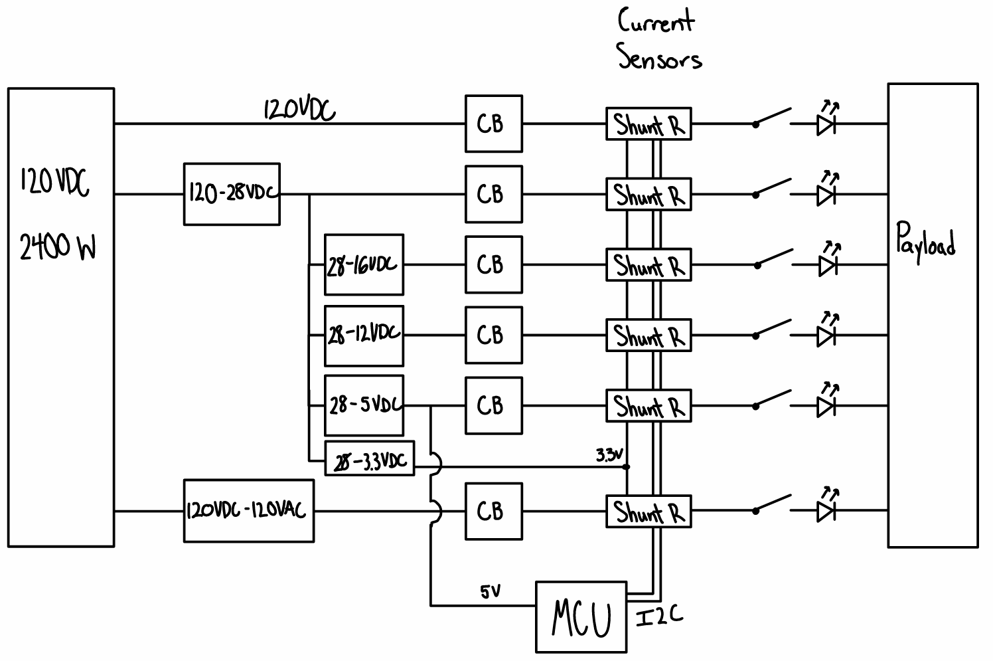
Initial Concept
Buck converters will be used to step-down from 120VDC
Circuit breakers serve to protect the payload and system components
Current sensors in shunt provide data over I2C
Manual switches control each output

Slide 9
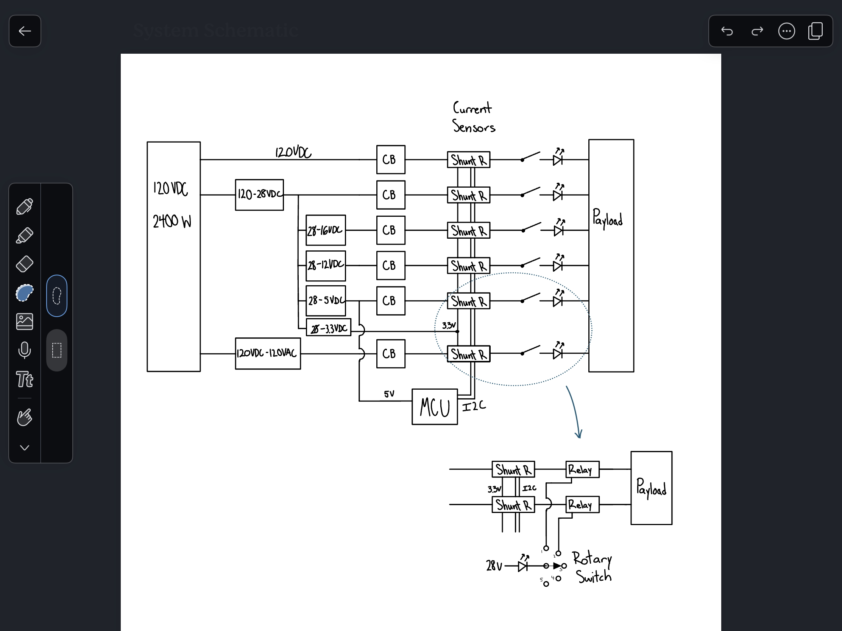
Single Output Design
Rotary switch allows for a cleaner control interface
Only one output can be on at a time for each payload

Slide 10
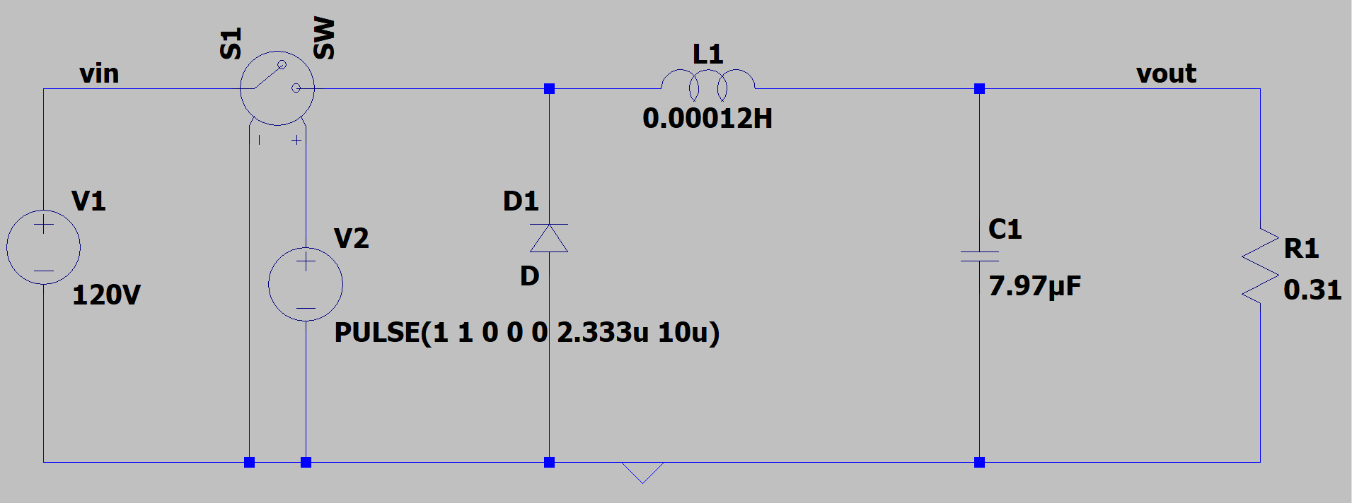
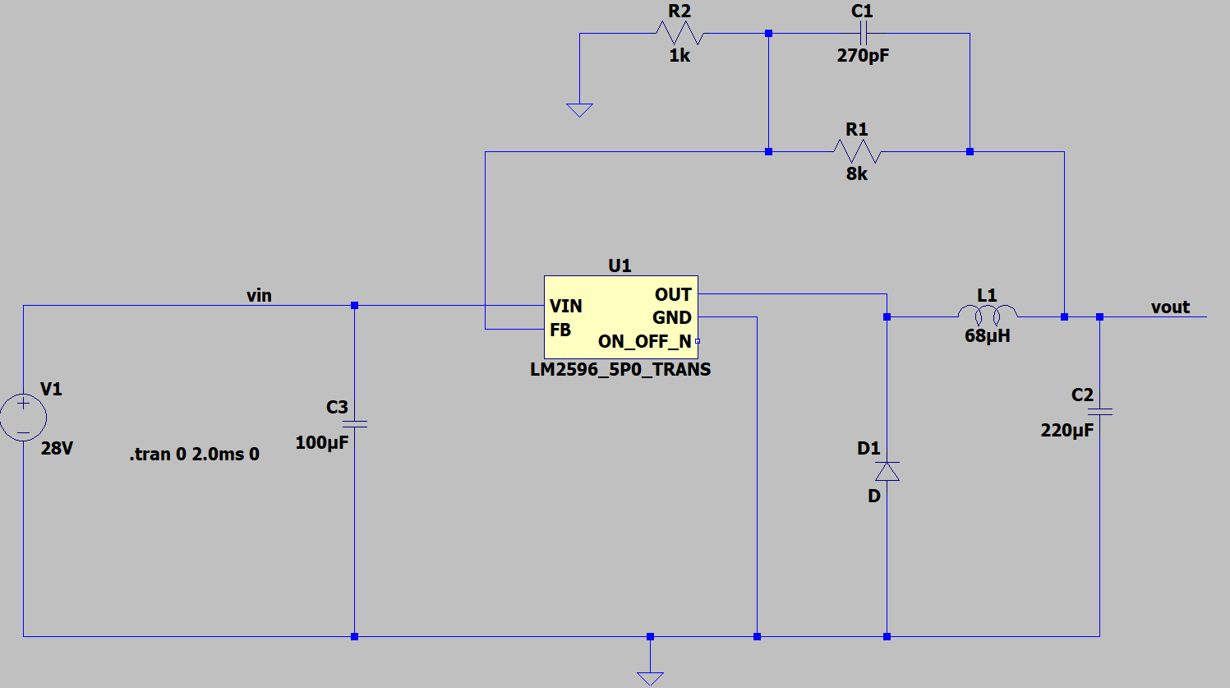
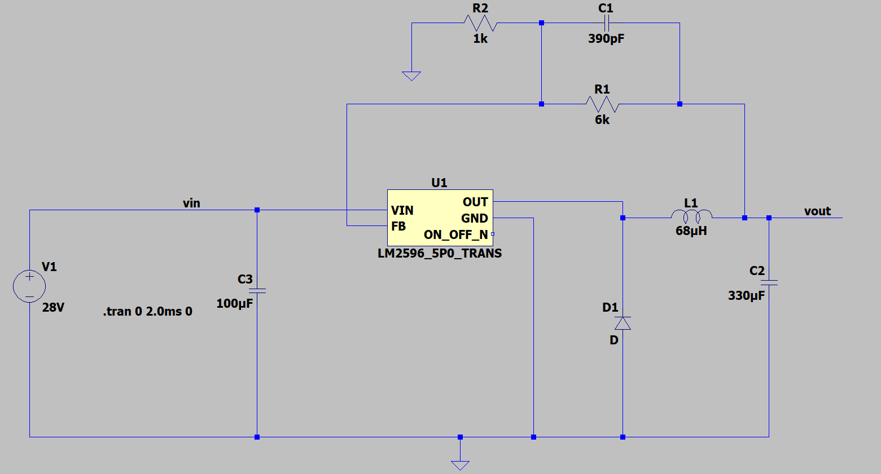
Converter Schematics
120VDC to 28VDC
28VDC to 16VDC
28VDC to 12VDC

Slide 11
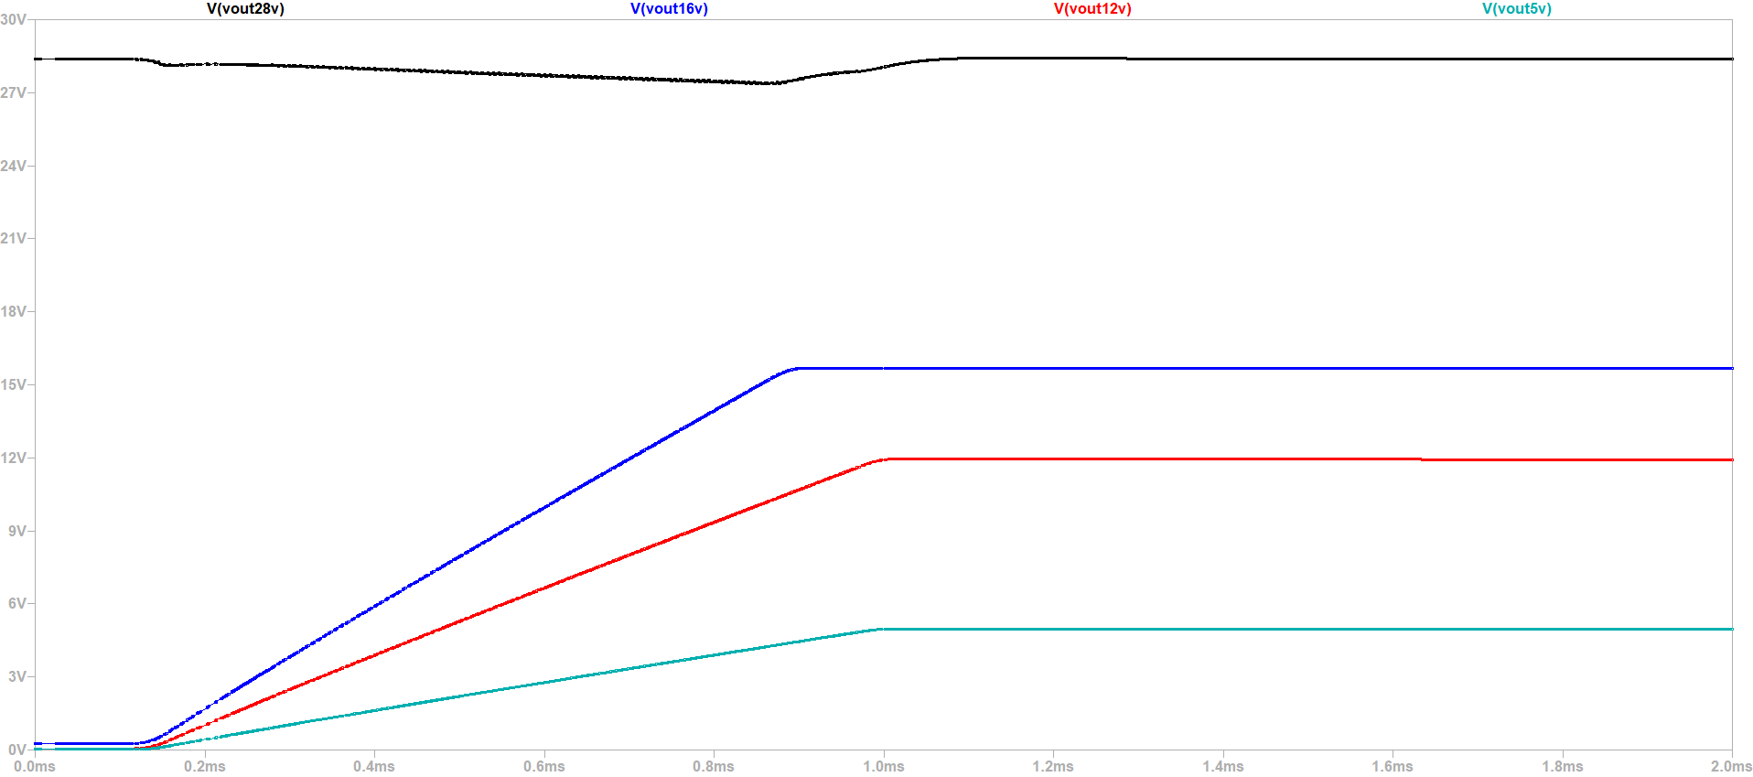
Converter Simulations

Slide 12
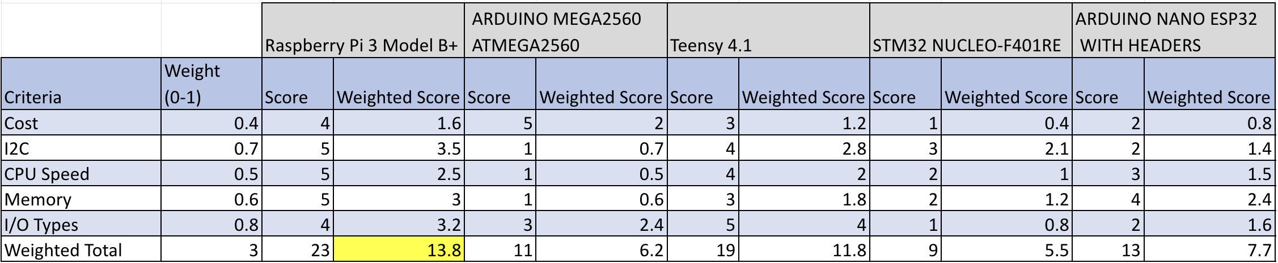
Microcontroller: Raspberry Pi 3

Slide 13
Progress to Date
ID | Milestone | Planned | Actual
01 | Kickoff Meeting | Sept 16, 2025 | Sept 16, 2025
02 | Finish Power Distribution Research | Oct 23, 2025 | Oct 23, 2025
03 | Complete Initial Schematic Design | Oct 23, 2025 | Oct 23, 2025
04 | Finalize I2C Current Sensor Implementation | Nov 4, 2025 | Nov 7, 2025
05 | Successful System Simulation | Nov 7, 2025 | Nov 7, 2025
06 | PDR Presentation and Report | Nov 13, 2025 | Nov 13, 2025
07 | Component Order | Nov 17, 2025
08 | Prototype for One Payload | Nov 25, 2025
09 | CDR Presentation & Report | Dec 4, 2025

Slide 14
Challenges and Risks
DC-AC Inverter
Use of custom PCB
PCB design may be used for power monitoring

Slide 15
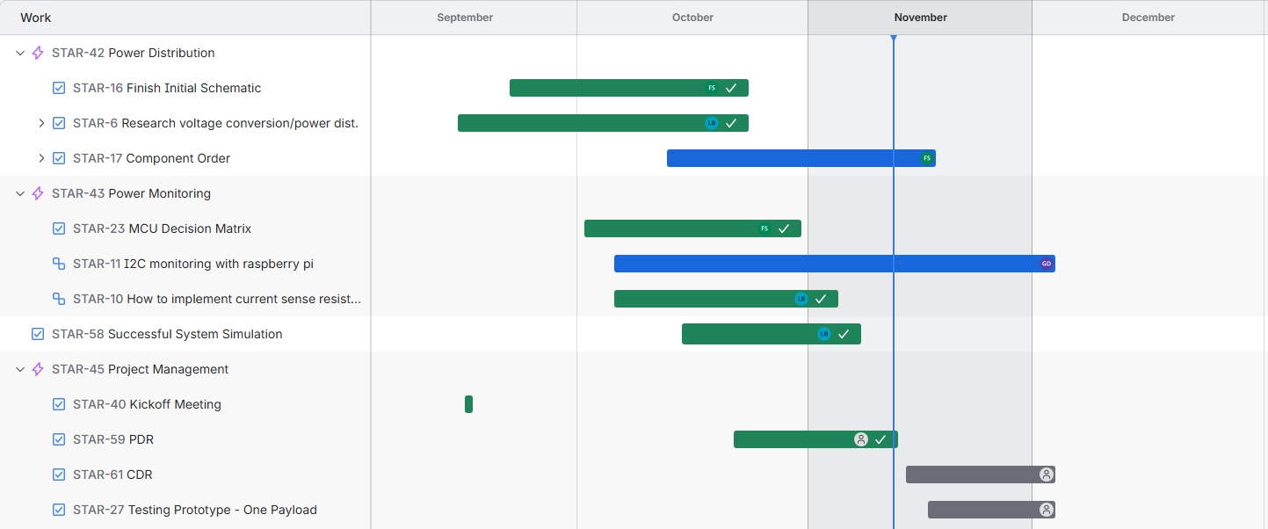
Next Steps

Slide 16
Summary
Power Delivery
6 outputs using 4 converters
Power Monitoring/Control
Shunt resistors communicating with MCU via I2C
Manual switches

